Slide 1
Lili Cai, 6th yr, Ilana Witten lab
Interest in teaching any of the bootcamp next semester?
Contact Ed Clayton/Alex Michaud
Today’s goal: learn about genetic + molecular tools to answer neuroscience questions.
Recommended readings:
Carter & Shieh Research Techniques in Neuroscience

Slide 2
Why do we care about genetics and molecular biology?
Single genes can drive behavior
Example: activation of foma-1 neurons in fly causes escape behavior (5:27)
https://www.jove.com/video/50192/optogenetic-stimulation-of-escape-behavior-in-drosophila-melanogaster
Groups of cells can drive behavior (show supplemental movie )
Example: CAMKII:CHR2 MPA-vPAG object tracking
https://www.nature.com/articles/s41593-018-0072-x#Sec42
Specific cells can track behavior
Example: GCaMP imaging of PL-NAc neurons during behavior

Slide 3
Topics:
Neural cell types
What makes a cell special?
Proteins (ie. to handle glutamate vs. dopamine vs. GABA)
Brain region
Anatomical connection
Genetic engineering
How to find genes of interest? How are genes expressed?
Recording neural activity
Fluorescent imaging, voltage sensitive dyes
Manipulating neural activity
Optogenetics, DREADDs

Slide 4
Neuronal cell types (mammals)
Neurotransmitter / neuromodulator it emits
Glutamate, GABA, dopamine, serotonin, etc.
Associated proteins: glutamate transporter (VGlut), gaba transporter (VGat), dopamine transporter (DAT), tyrosine hydroxylase (TH), etc.
Neurotransmitter / neuromodulator it receives
Glutamate, GABA, dopamine, serotonin, etc.
Associated proteins: Glutamate receptor, GABA receptor, dopamine receptor, serotonin receptor
Brain region
Anatomical connection - who it received input from, who it gives input to

Slide 5
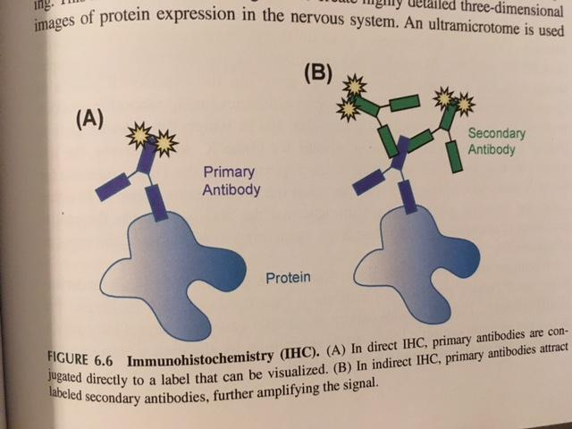
How do we know which neurotransmitter a neuron emits / receives?
Add fluorescent labels to proteins or RNA
Immunostaining for proteins
RNAseq (staining for RNA)
Example of immunostaining:
(show ndp2.view file)

Slide 6
How do we know what brain region a neuron is in?
Atlas of mouse brain → stereotaxic coordinates used for surgery
Allen Brain Atlas
Paxinos Brain Atlas

Slide 7
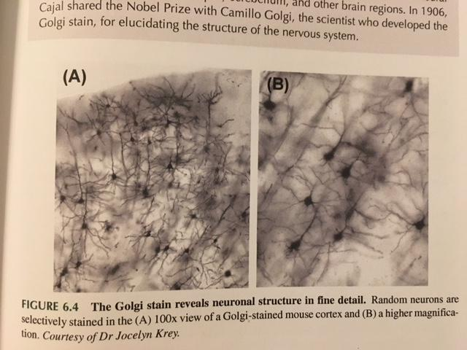
How do we know how neurons are connected to each other?
Old school way: dye tracing

Slide 8
How do we know how neurons are connected to each other?
Anatomical Tracing: labeling neurons using fluorescent tags
Anterograde tracing: inject in cell body location, labels axonal projections
Retrograde tracing: inject in axon terminals, labels cell bodies that project to this region
Trans-synaptic labeling:
Rabies or pseudo-rabies virus ‘jumps’ synapses

Slide 9
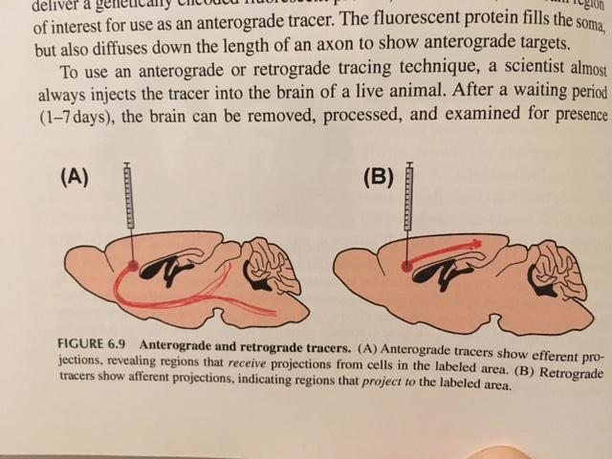

Slide 10
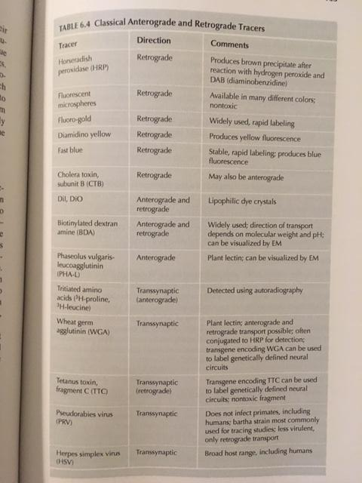

Slide 11
Topics:
Neural cell types
What makes a cell special?
Proteins (ie. to handle glutamate vs. dopamine vs. GABA)
Brain region
Anatomical connection
Genetic engineering
How to find genes of interest? How are genes expressed? How to insert genes?
Recording neural activity
Fluorescent imaging, voltage sensitive dyes
Manipulating neural activity
Optogenetics, DREADDs

Slide 12
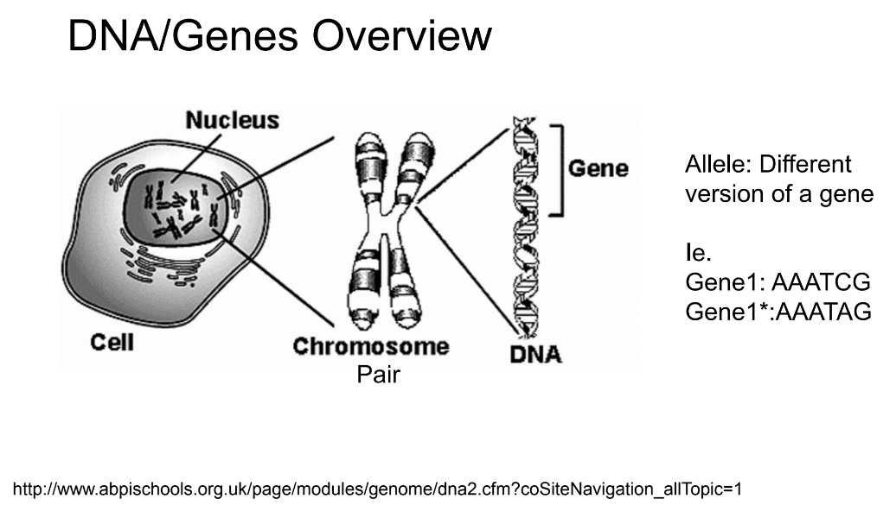
Everyone has 2 alleles for each gene, one from each parent.

Slide 13
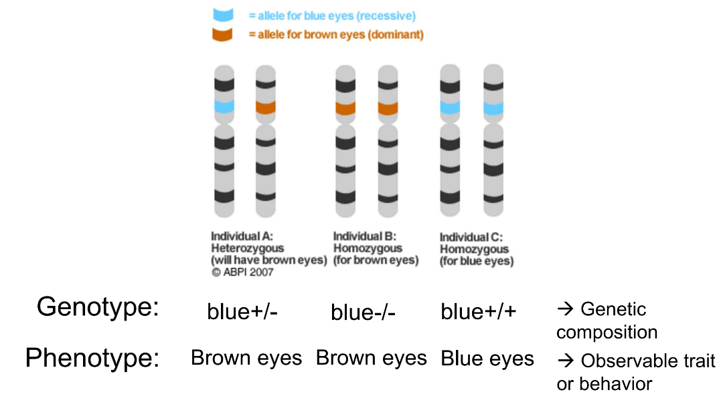

Slide 14

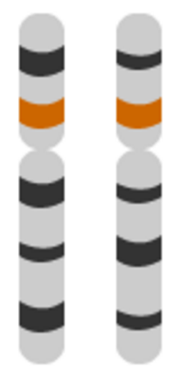
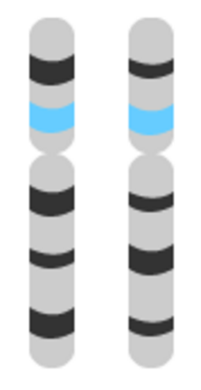

Slide 15
How do we find genes of interest?
How do we isolate genes of interest?
How do we deliver genes to animals?

Slide 16
How do we find genes of interest?
Genetic screens
In silico screens
Molecular screens

Slide 17
Genetic Screens
Forward genetic screen
Usually uses genetic model organisms
Test multiple genes and look for an abnormal phenotype
Quantify phenotype using an assay
Develop mutant lines using UV light, chemicals etc to damage and cause mutations in the DNA
Map the gene (linkage analysis)
Mate mutant animal with another known mutant phenotype. If traits are inherited together, more likely they are on the same chromosome.
“hypothesis generating”
Reverse genetic screen
Test 1 candidate gene and look for abnormal phenotype
“hypothesis testing”

Slide 18
In Silico Screens
Use existing genetic databases (ie. BLAST, Ensembl)
Compare similar DNA from multiple species
High sequence similarity could potentially lead to similar functions

Slide 19
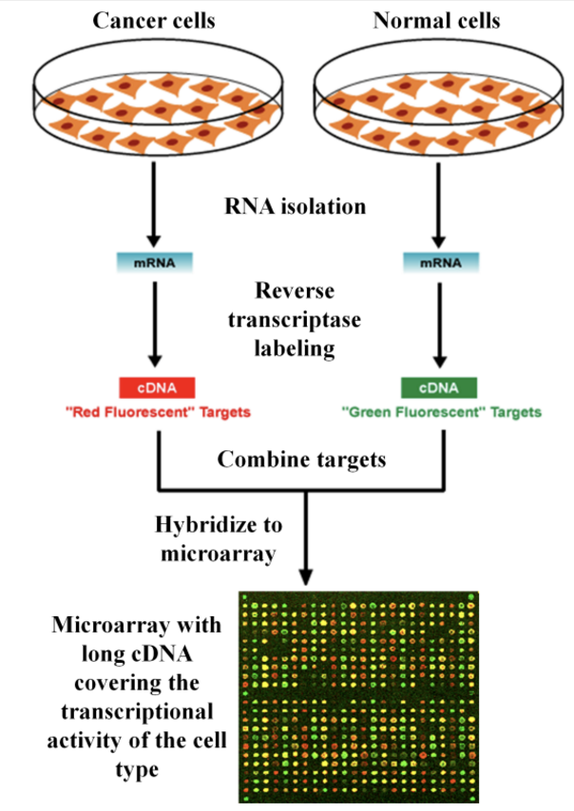
Molecular Screens
cDNA microarray screen
Works when: gene expression is tightly regulated, genes expressed when useful
Example: Which genes are involved in night vs day?
Take biological sample → RNA → use enzyme to make complementary DNA (cDNA) → pour cDNA onto microarray
Microarray has thousands of tiny DNA sequences of known genes, computer can detect which spots on the microarray have expression

Slide 20
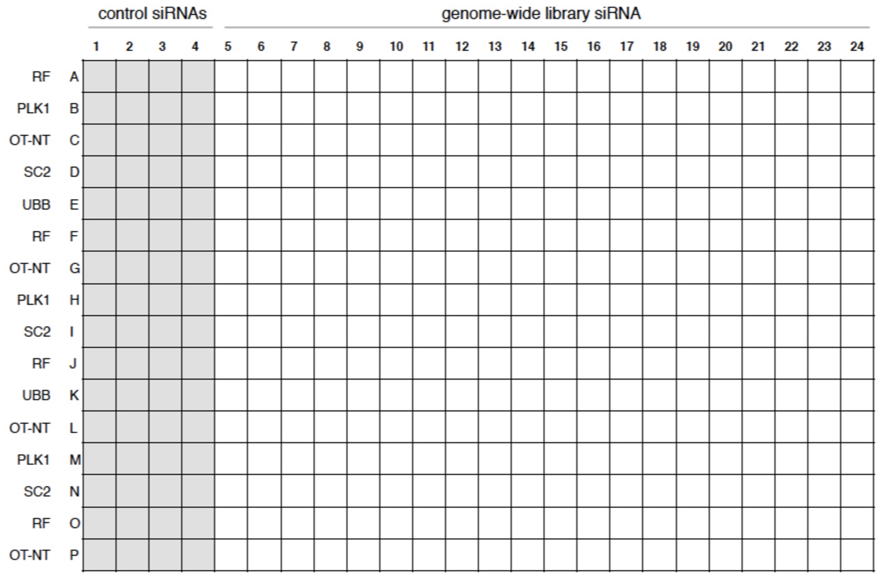
Molecular Screens
RNA interference (RNAi)
Mostly used for cellular processes in worms or cell culture
Different RNAi molecules are put into a well of assays
Cells are put into each well, differences in expression and proliferation observed

Slide 21
How do we isolate and clone genes of interest?
Molecular Cloning: isolating and cutting piece DNA out of genome
Restriction enzymes cut at recognition sites (4-8 nucleotides)
Use PCR to amplify DNA fragment of interest
Uses primers (single-stranded oligonucleotides) for binding to region flanking sequence of interest

Slide 22
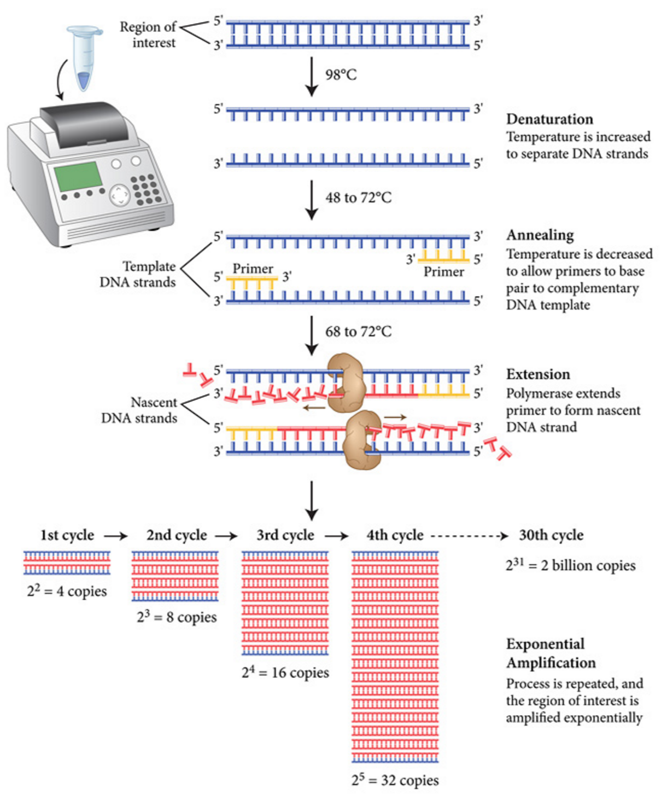

Slide 23
How do we isolate and clone genes of interest?
Molecular Cloning: isolating and cutting piece DNA out of genome
Restriction enzymes cut at recognition sites (4-8 nucleotides)
Use PCR to amplify DNA fragment of interest
Uses primers (single-stranded oligonucleotides) for binding to region flanking sequence of interest
Recombinant DNA: recombining different pieces of DNA
Create a vector of DNA
Creating transgenic animals
DNA Sequencing (transfect recombinant DNA into bacteria or yeast to amplify even more, and then purify and sequence the results using Northern Blot, Southern Blot, etc. )

Slide 24
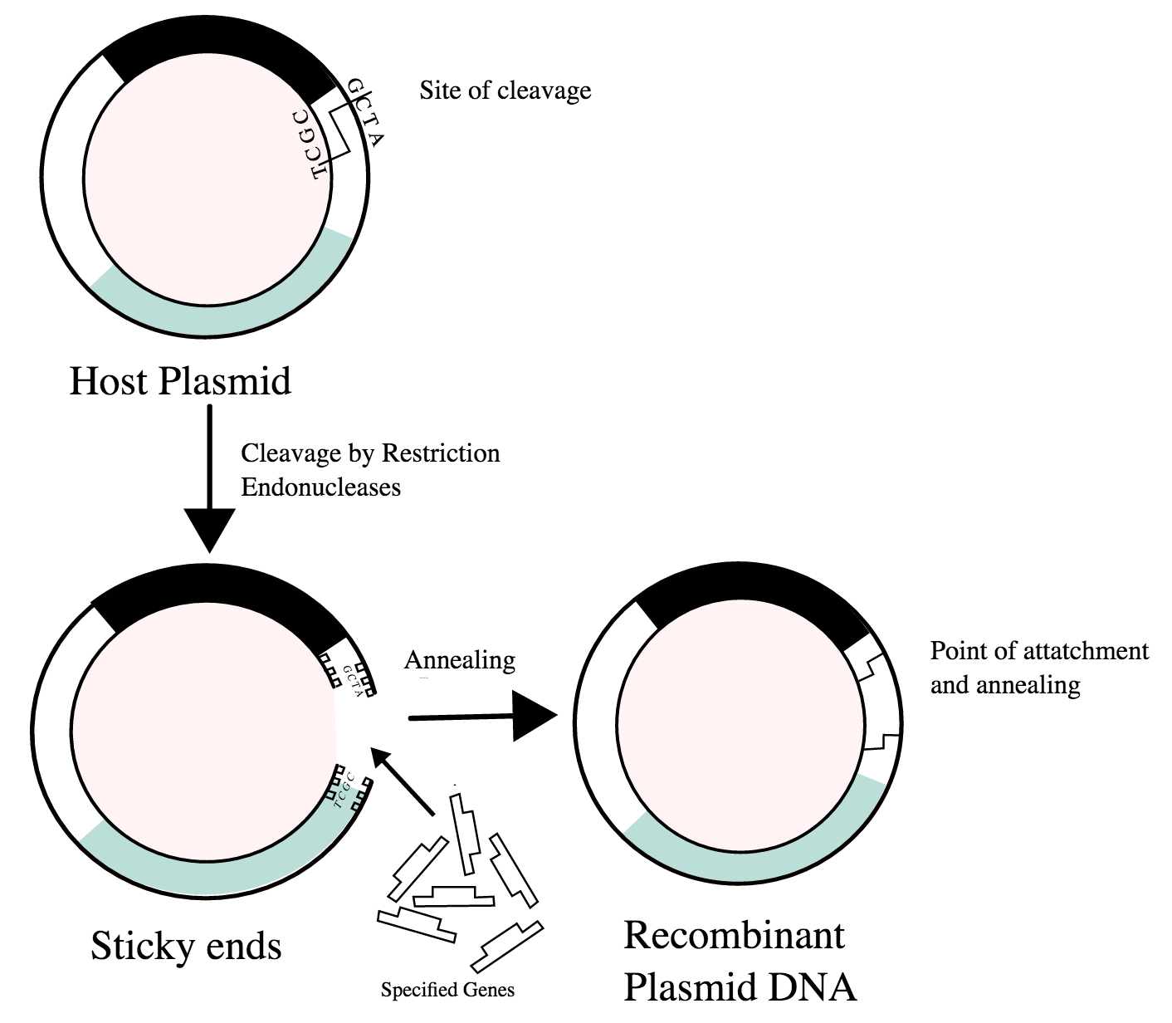

Slide 25
How do we deliver genes (recombinant DNA) to animals?
Transfection: non-viral delivery of DNA to cells
Physical gene delivery
Microinjection
Electroporation
Biolistics (gene gun)
Chemical gene delivery
Calcium phosphate
Lipid transfection
Infection: viral DNA delivery to cells
Pros and cons of each delivery strategy:
Expression timeline
Cell damage

Slide 26
Topics:
Neural cell types
What makes a cell special?
Proteins (ie. to handle glutamate vs. dopamine vs. GABA)
Brain region
Anatomical connection
Genetic engineering
How to find genes of interest? How are genes expressed? How to insert genes?
Recording neural activity
Fluorescent imaging, voltage sensitive dyes
Manipulating neural activity
Optogenetics, DREADDs

Slide 27
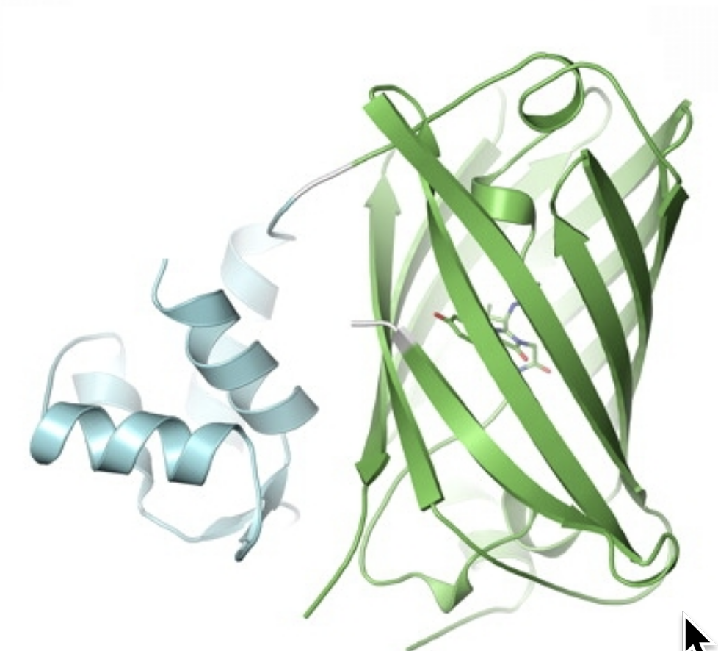
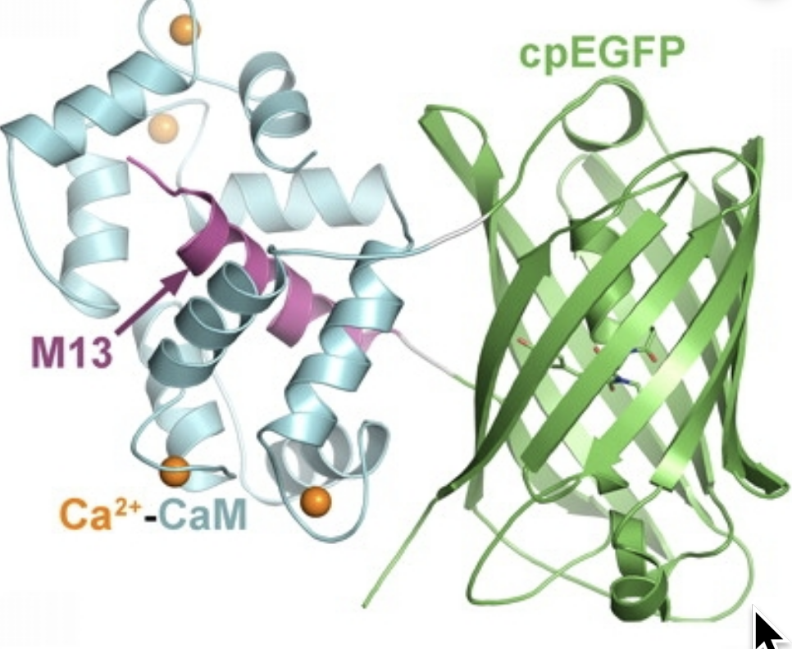
Recording calcium activity from neurons
GCaMP is a protein fused of 3 sub-proteins: Calmodulin, M13, Green fluorescent protein (GFP)
Poor absorption at excitation wavelength
Poor fluorescence
Bound to calcium: good fluorescence

Slide 28
Show GCaMP animation, example

Slide 29
How do we express GCaMP in neurons?
Cre/lox system
Flp/FRT system
Transgenic mice

Slide 30
Every gene has a promoter
Promoter:
DNA sequence (usually located BEFORE the gene of interest) that allows RNA polymerase to bind and start the first step of protein making from gene of interest.

Slide 31
Cre/Lox system
Lox: a sequence of DNA (it does not encode a gene)
Cre recombinase: a protein that likes to cut sequences that start and end with Lox, and paste them upside down
DIO or FLEX: when a gene is sandwiched between two lox sites
AKA: “double-floxed inverse”, “flex-on”, “flex-off”
Virus lingo: AAV5-EF1a-DIO-GCaMP-eYFP
Aav5: virus serotype (type of plasmid). Ie. AAV2, AAVdj, AAV9, etc. EF1a: general promoter DIO: means GCaMP is flipped in between two lox sites eYFP: fluorescent marker so you can see it in histology

Slide 32
Cre/Lox examples on the board
Example cre mice: DAT-Cre, VGAT-cre, VGLUT-cre
Example virus injections to go in cre mice: DIO-GCaMP, DIO-ChR2
Knock in vs. knock out genes

Slide 33
Suppose you want to infect pyramidal (excitatory cells) with GCaMP in mouse cortex. How do you do it?
One possible solution:
Buy a transgenic VGlut-Cre mouse from Jackson Labs
Inject Cre-dependent GCaMP (ie. AAV5-EF1a-DIO-GCaMP-eYFP) into mouse cortex, implant an optic fiber
Wait 2 weeks for virus expression
Image the mouse! Look at cells

Slide 34
Suppose you are really lazy and don’t want to do virus injections. How might you express GCaMP in pyramidal neurons in mouse cortex?
One possible solution:
Mate two mice:
VGlut-Cre: Mice express Cre in all VGlut neurons
Ai148: mice express GCaMP under the promoter Cre
VGlut-Cre x Ai148: Mice express GCaMP in all VGlut neurons
Implant optic fiber, wait ~5 days for surgery to heal, image the mouse!
Library of possible mice that can be purchased:
https://www.biorxiv.org/content/biorxiv/early/2017/11/25/224881.full.pdf

Slide 35
But wait, I work with flies...
Gal4/UAS system in flies

Slide 36
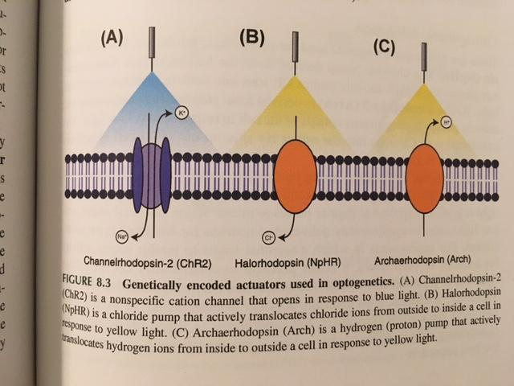
Optogenetics
Engineered ion channels that are sensitive to light
Express these ion channels in cells of interest
Examples:
Excitatory: ChR2 (blue), Chronos (blue, faster)
Inhibitory: NpHR (yellow), Chrimson (red)

Slide 37
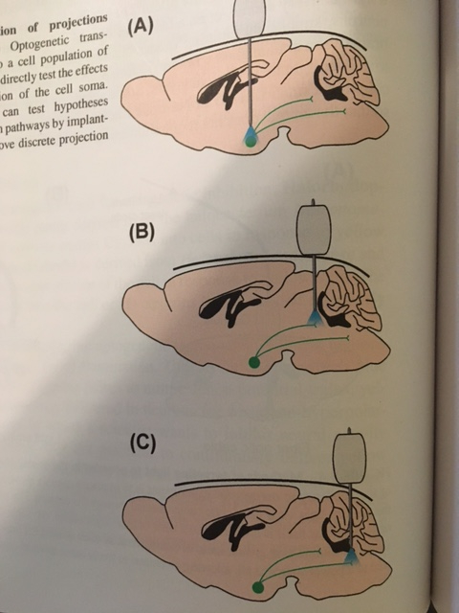
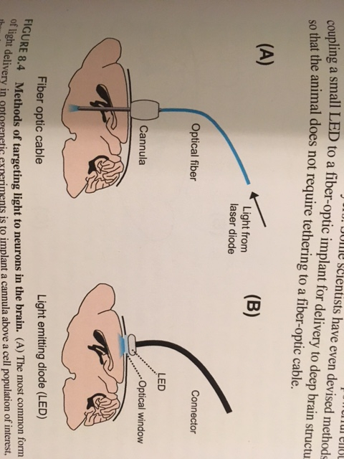

Slide 38
Why do we care about genetics and molecular biology?
Single genes can drive behavior
Example: activation of foma-1 neurons in fly causes escape behavior (5:27)
https://www.jove.com/video/50192/optogenetic-stimulation-of-escape-behavior-in-drosophila-melanogaster
Groups of cells can drive behavior
Example: CAMKII:CHR2 MPA-vPAG object tracking??
https://www.nature.com/articles/s41593-018-0072-x#Sec42
Specific cells can track behavior
Example: GCaMP imaging of PL-NAc neurons during behavior

Slide 39
DREADDs
Designer receptors exclusively activated by designer drugs

Slide 40
Extra questions?
Link to discussion questions:
https://docs.google.com/document/d/12FtdzkoesAolTR0OoITt6fjGQRWYwlCuf6ieoDaXrHY/edit?usp=sharing

